Slide 1
Dijkstra Algorithm

Slide 2
Properties
Dijkstra's algorithm is an algorithm which finds the shortest distance between nodes in a graph. It was conceived by Edward Dijkstra in 1956 and published three years later.
The algorithm exists in many variants; Dijkstra's original variant found the shortest path between two nodes, but a more common variant fixes a single node as the "source" node and finds shortest paths from the source to all other nodes in the graph, producing a shortest path tree
Dijkstra’s algorithm finds the shortest path which are discovered in the order of their weighted lengths from shortest to longest.
At first all the distances are regarded as INFINITY except for the start or source node for which the distance is set as ZERO.

Slide 3
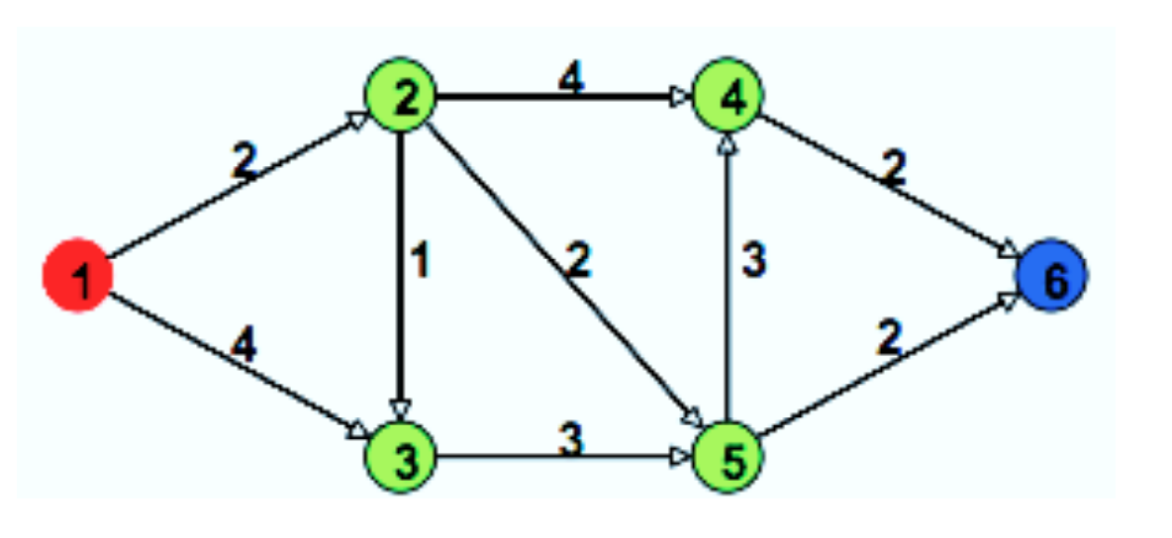
Properties
Dijkstra algorithm finds single source shortest path for both directed and undirected graph
To perform Dijkstra algorithm all edges must have non negative weights
Graphs must be connected

Slide 4
Working of Dijkstra Algorithm
Animation showing the working of Dijkstra

Slide 5
Algorithm of dijkstra
At first we create a set sptSet (shortest path tree set) that keeps track of vertices included in shortest path tree, i.e., whose minimum distance from source is calculated and finalized. Initially we keep this set as empty.
Then we assign a distance value to all vertices in the input graph. So we initialize all distance values as INFINITE and source vertex as zero so that it should be picked first.
Then while sptSet doesn't include all the steps:
We take a vertex u which is not there in sptSet and it has minimum distance value
Then we include u to sptSet
Then we will have to update distance value of all adjacent vertices of u. To update the distance values, we need to iterate through all adjacent vertices.
For every adjacent vertex v, if sum of distance value of u (from source) and weight of edge u-v, is less than the distance value of v, then we need to update the distance value of v.

Slide 6
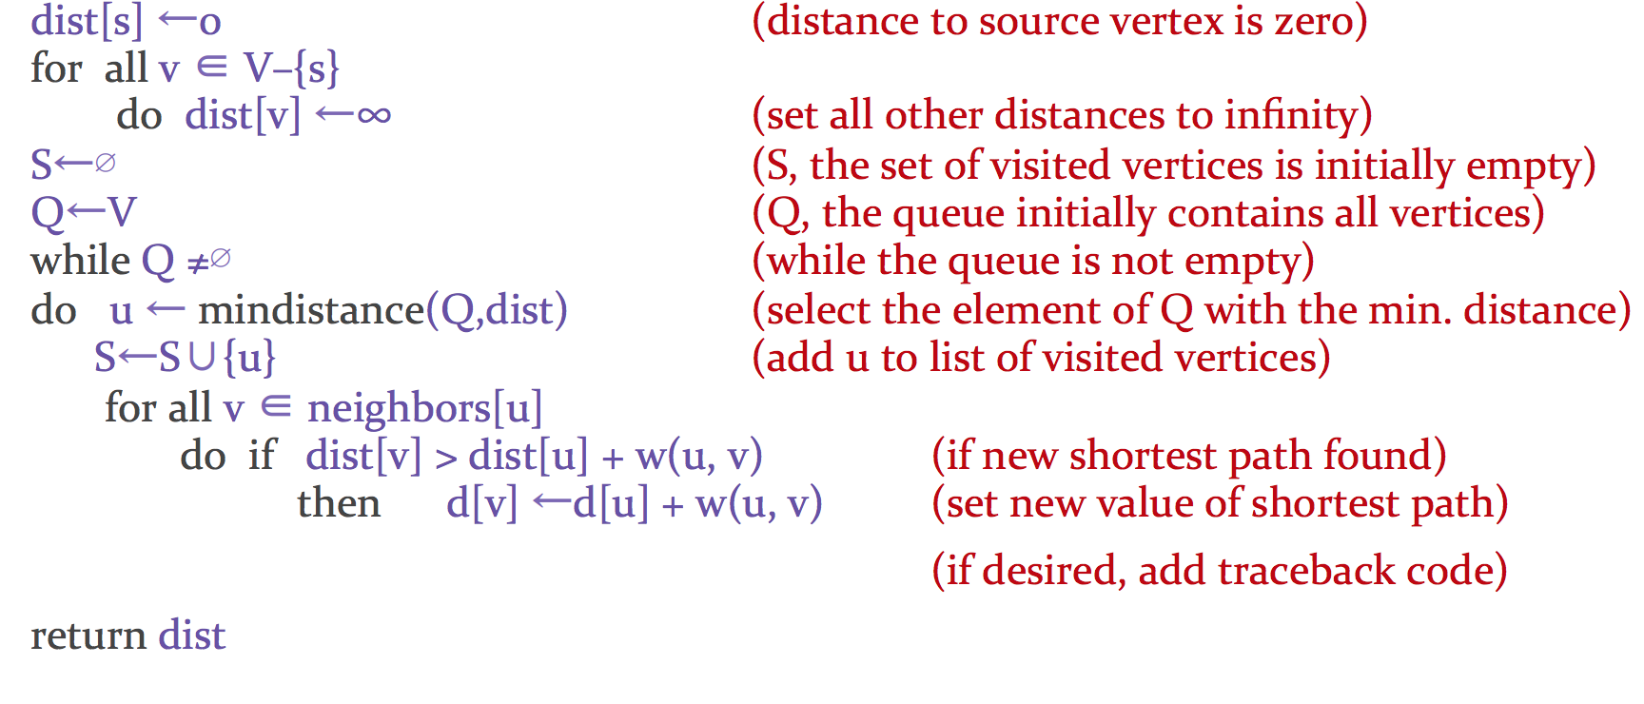
Pseudocode of the Algorithm

Slide 7
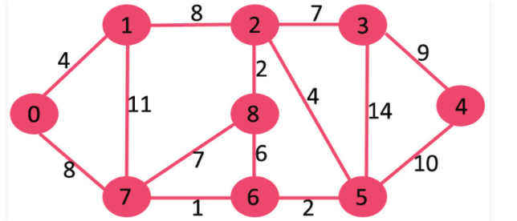
Working example of dijkstra
This is the graph on which we will be performing dijkstra algorithm to find the single source shortest path
The graph as we can see is connected and have positive weights

Slide 8
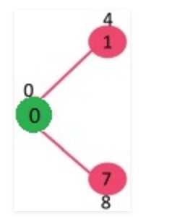
Working example of dijkstra
The set sptSet is initially empty and distances assigned to vertices are {0, INF, INF, INF, INF, INF, INF, INF} where INF indicates infinite. Now we pick the vertex with minimum distance value. Hence vertex 0 is picked and we include it in sptSet. So sptSet becomes {0}. After including 0 to sptSet, we update distance values of its adjacent vertices. Adjacent vertices of 0 are 1 and 7. The distance values of 1 and 7 are updated as 4 and 8. The following subgraph shows vertices and their distance values, the vertices with finite distance values are shown here .The vertices included in SPT are shown in green color.

Slide 9
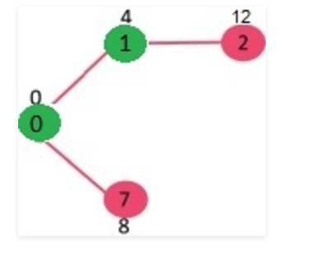
Working example of dijkstra
Then we pick the vertex with minimum distance value and which is not already included in SPT .The vertex 1 is picked and added to sptSet. So sptSet now becomes {0, 1}. The we update the distance values of adjacent vertices of 1. The distance value of vertex 2 becomes 12.

Slide 10
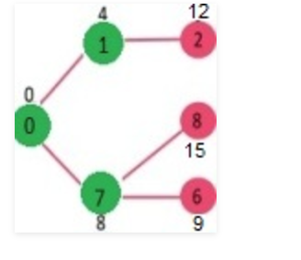
Working example of dijkstra
Then we again pick the vertex with minimum distance value and not already included in SPT (Vertex 7 is picked. So sptSet now becomes {0, 1, 7}. Then we update the distance values of adjacent vertices of 7. The distance value of vertex 6 and 8 becomes finite (15 and 9 respectively).

Slide 11
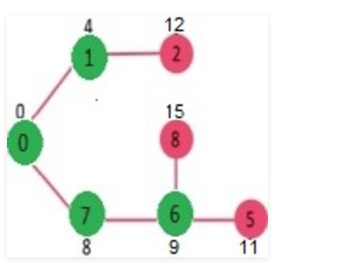
Working example of dijkstra
Then we again pick the vertex with minimum distance value and not already included in SPT .Vertex 6 is picked. So sptSet now becomes {0, 1, 7, 6}. Update the distance values of adjacent vertices of 6. The distance value of vertex 5 and 8 are updated.

Slide 12
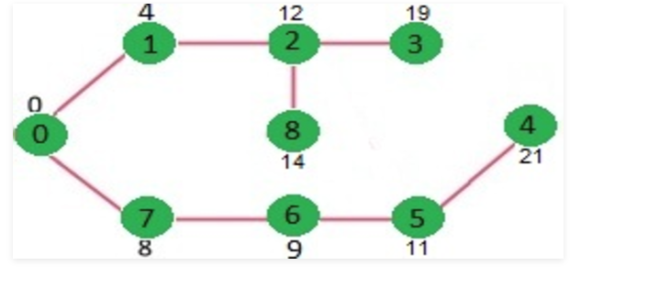
Working example of dijkstra
We repeat the earlier steps till sptSet include all the vertices of the graph given and hence finally we get this graph. These are the shortest distance to every other node from the start node.

Slide 13
Practical application of dijkstra
Distances between the cities for the minimum route calculation for transportation
Game Development
Cognitive Science
For Establishing the network cables these play important role in finding the minimum cables required to cover the whole region
Open Shortest Path First, used in Internet routing. It uses a link-state in the individual areas that make up the hierarchy. The computation is based on Dijkstra's algorithm which is used to calculate the shortest path tree inside each area of the network

